Slide 1
July 2024
Facilities Time Reporting 2024
(Period April 2023 – March 2024)

Slide 2
Reporting Requirement
The Trade Union (Facility Time Publication Requirements) Regulations 2017 came into force on 1 April 2017
The Regulations place a legislative requirement on relevant public sector employers to collate and publish, on an annual basis, a range of data on the amount and cost of paid trade union facility time over the course of the relevant 12-month period.
This information is for April 2023 to March 2024.
The Government has confirmed that the deadline for reporting on trade union facilities time (time off from an individual's job to carry out a trade union role), will be 31st July 2024.
Schedule 2 of the Regulations confirm the information to be published, as follows:
    The total number of relevant union officials employed
    Percentage of time spent on facilities time
    Percentage of pay bill spent on facilities time
    Time spent on paid trade union activities as a percentage of total paid facilities time hours

Slide 3
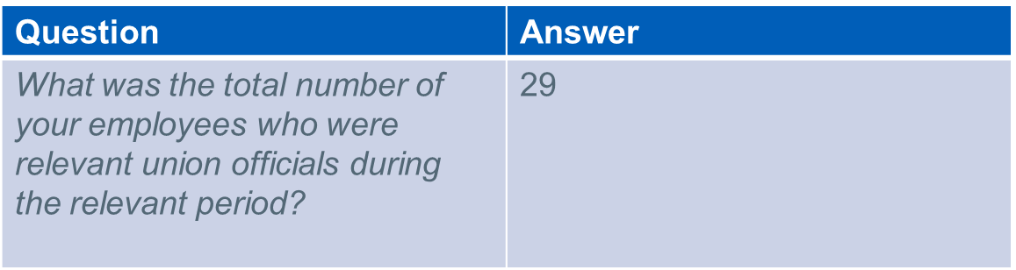
Schedule 2 – Information to be published
Table 1: Relevant union officials

Slide 4
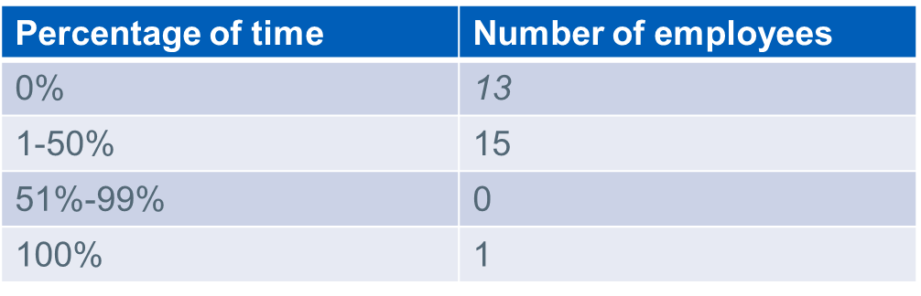
Schedule 2 –Information to be Published (2)
Table 2: Percentage of time spent on facilities time
How many of your employees who were relevant union officials employed during the relevant period spent a) 0%, b) 1%-50%, c) 51%-99% or d) 100% of their working hours on facility time?

Slide 5
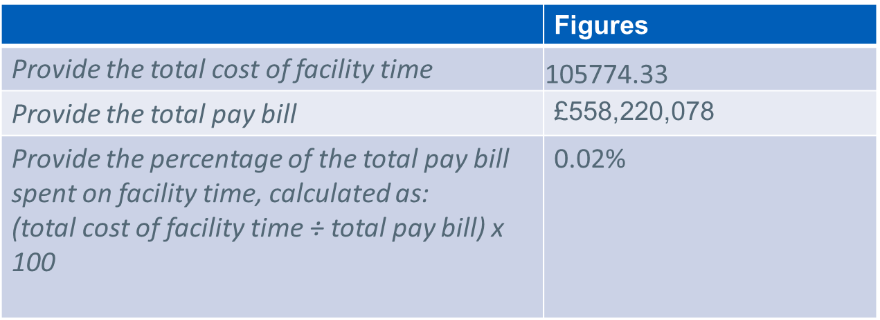
Schedule 2- Information to be Published (3)
Table 3: Percentage of pay bill spent on facility time

Slide 6
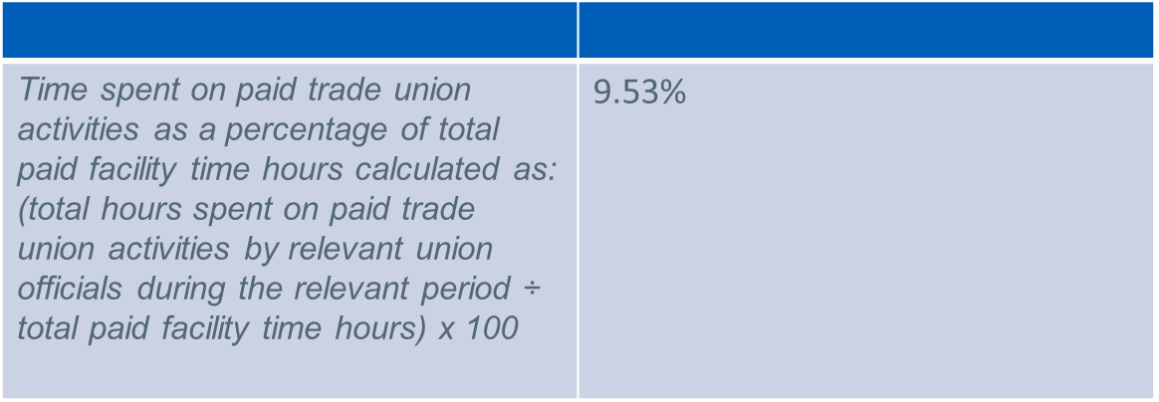
Schedule 2: Information to be Published (4)
Table 4: Paid trade union activities
As a percentage of total paid facility time hours, how many hours were spent by employees who were relevant union officials during the relevant period on paid trade union activities?

Slide 7
Thank you
Any questions ?

